Slide 1
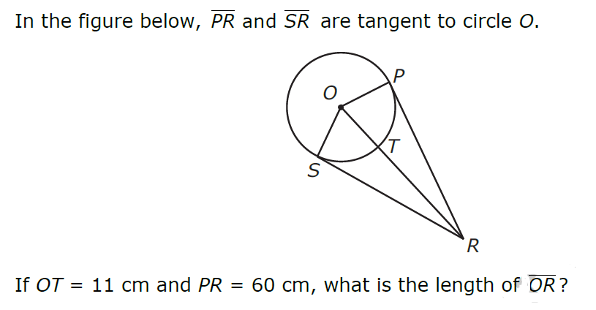
1.

Slide 2
7. What is the approximate length of the arc subtended (made by) an angle of 240 degrees on a circle with a radius of 6 meters?

Slide 3
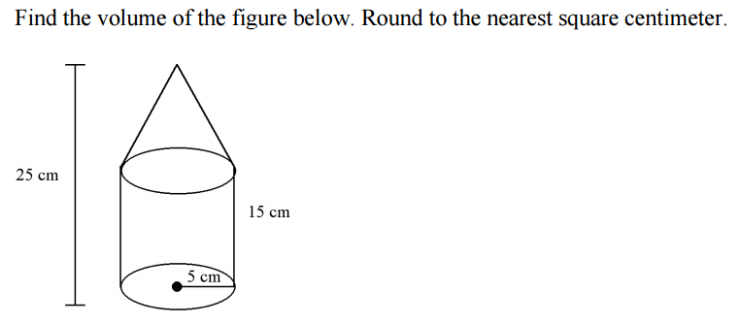
4.

Slide 4
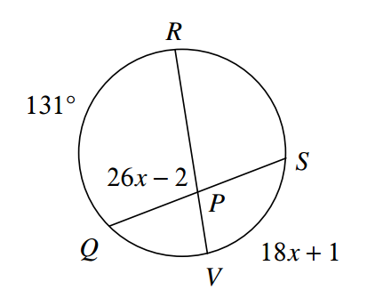
13.

Slide 5
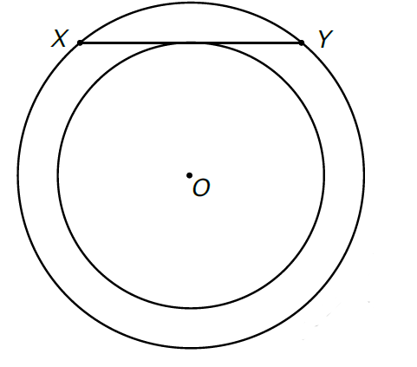
11. Chord XY is tangent to the smaller circle. The radius of the larger circle is 15 cm. The radius of the smaller circle is 12 cm. What is the length of chord XY?

Slide 6
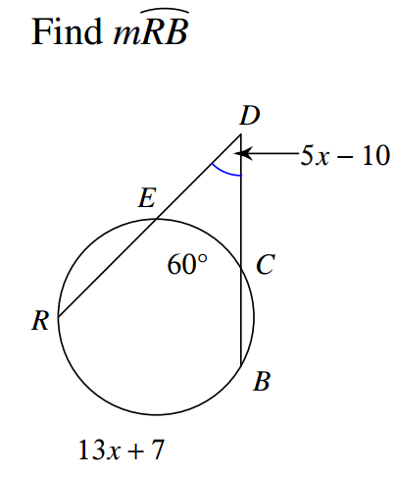
2. F

Slide 7
10. What is the radius of the following equation?

Slide 8
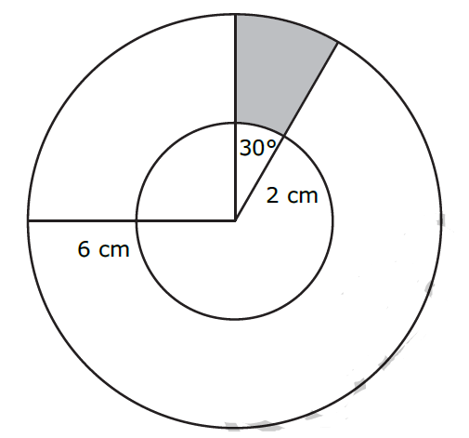
9. What is the approximate area of the shaded region?

Slide 9
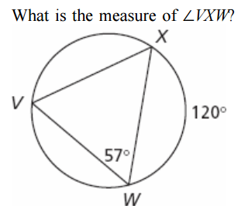
5.

Slide 10
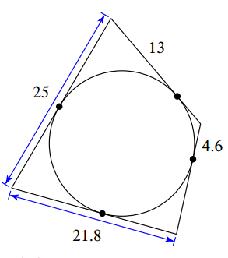
14. Find the perimeter of the following:

Slide 11
12. The diameter of a circle is 8 cm. A central angle of the circle intercepts an arc of 12 cm. What is the measure of the angle?

Slide 12
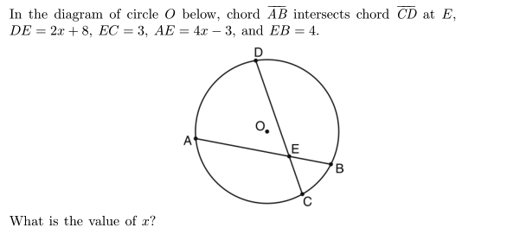
6.

Slide 13
3. The center of circle Q has coordinates (3,-2). If circle Q passes through R (7,1) , what is the length of its diameter?

Slide 14
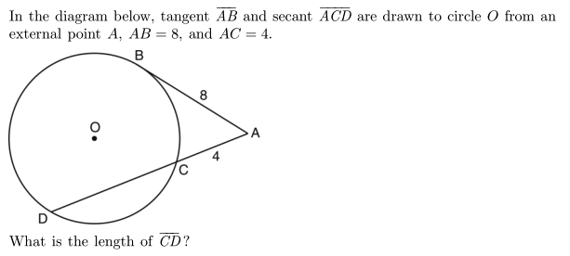
15.

Slide 15
8. To completely cover a spherical ball, a ball company uses a total area of 36 square inches of material. What is the maximum volume the ball can have?

Slide 16
20.3 6 25.13
1.
2.
3.
___ ___ ___
___ ___ ___ ___ ___ ___ ___ ___ ___
___ ___
___ ___ ___ ___ ___ ___ ___ !
3 61
150 18 78.8 12 25.13 3.6 10
Can you figure out my favorite phrase? Go through the scavenger hunt in order to earn clues to help figure out the riddle. In order to receive full credit, you must SHOW ALL YOUR WORK! Have fun and good luck!
Circle Scavenger Hunt
Go to a station, solve the question, then check your answer! It’s as easy as pi ☺
78.8 8.4 61 63 3.6 102 1440 78.8 8.4

Slide 17
4.
5.
6.
7.
8.
9.

Slide 18
10.
11.
12.
13.
14.
15.

Slide 19
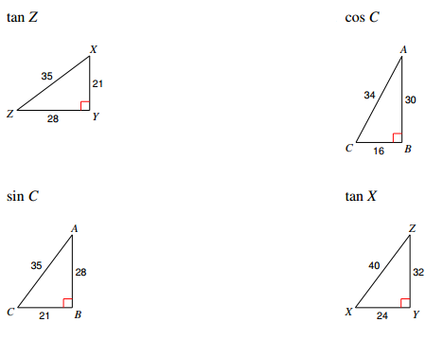
We have the three brothers...their ratios are
5. 6.
7. 8.
1. 2.
3. 4.
sinθ = ___________ cosθ = ___________ tanθ = ___________
Now, set up each trig ratio for the unknown angle but do not solve
Next, go back and solve triangles 1-4. Once done, solve 5-8
Remember Those Hippies?

Slide 20
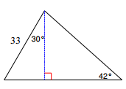
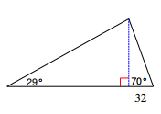
9. 10.
Those hippie brothers are at it again—except on the ski slopes!!
Draw a picture that represents each word best then solve the following questions:
Elevation Depression
Sometimes it takes an extra step to figure out the solution. Solve the next two triangles:
11. From a point on the ground 12 ft from the base of a flagpole, the angle of elevation of the top of the pole measures 53°. How tall is the flagpole?
12. From an airplane at an altitude of 1200 m, the angle of depression to a rock on the ground measures 28°. Find the distance from the plane to the rock.

